Slide 1
Aspect Oriented Programming AOP
SoftUni Team
Technical Trainers
Software University
https://softuni.bg

Slide 2
Table of Contents
What is AOP
Why do we use AOP?
AOP Concepts and Terminologies
Spring AOP AspectJ Annotations
Examples

Slide 3
Have a Question?
sli.do #java-web

Slide 4

What is AOP

Slide 5
Aspect Oriented Programming AOP (1)
AOP breaks the program logic into distinct parts (called concerns)
Cross-cutting concern
Concern that can affect the whole application and should be centralized in one location, such as transaction management, authentication, logging, security etc.

Slide 6

Why We Use AOP

Slide 7
Why Use AOP
To dynamically add the additional concern before, after or around the actual logic
Suppose that we have to maintain methods and needs to do actions before or after they are called
We can solve the problem with or without AOP

Slide 8
Why Using AOP – Problem Example
Student class with some methods whose activity we want to track
public class Student{
public void actionOne(){...};
public void actionTwo(){...};
public void actionThree(){...};
public void actionFour(){...};
public void actionFive(){...};
}

Slide 9
Why Using AOP – Problem Solution
Solution without AOP
If we need to log all activity of student, we need to write additional code in all tracked methods
It leads to the maintenance problem.
Solution with AOP
We can define the additional concern like maintaining log, sending notification, etc. in the method of a class
Maintenance is easy in AOP

Slide 10

AOP Concepts and Terminology

Slide 11
Terminologies
The AOP concepts and terminologies are
Join point
Advice
Pointcut
Introduction
Target Object
Aspect
Interceptor
AOP Proxy
Weaving

Slide 12
Join Point
Join point
A Join point is any point in your program such as method execution, exception handling, field access etc.
We can have many Join points
Spring supports only the method execution join point

Slide 13
Advices and Types
Represents an action taken by an aspect at a join point
Before Advice: it executes before a join point
After Returning Advice: it executes after a joint point completes normally
After Throwing Advice: it executes if method exits by throwing an exception
After Advice: it executes after a join point regardless of join point exit whether normally or exceptional return
Around Advice: It executes before and after a join point

Slide 14
Pointcut, Introduction, Target Object
Pointcut
It is an expression language of AOP that matches join points
Introduction
Introduction of additional method and fields for a type
Target Object
The object i.e. being advised by one or more aspects
Also known as Proxied Object

Slide 15
Aspect, Interceptor, AOP Proxy, Weaving
Aspect
A class that contains advices
Interceptor
An aspect that contains only one advice
AOP Proxy
Used to implement aspect contracts, created by AOP framework
Weaving
The process of linking aspect with other application types or objects to create an advised object.

Slide 16
Spring AOP AspectJ Annotations

Slide 17
Spring AOP AspectJ (1)
The 3 ways to use spring AOP are
By Spring 1.2 old style
By AspectJ annotation-style
The widely used approach is Spring AspectJ Annotation Style
By Spring XML configuration-style(schema based)

Slide 18
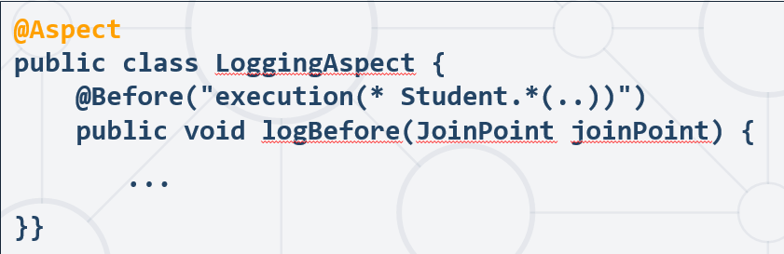
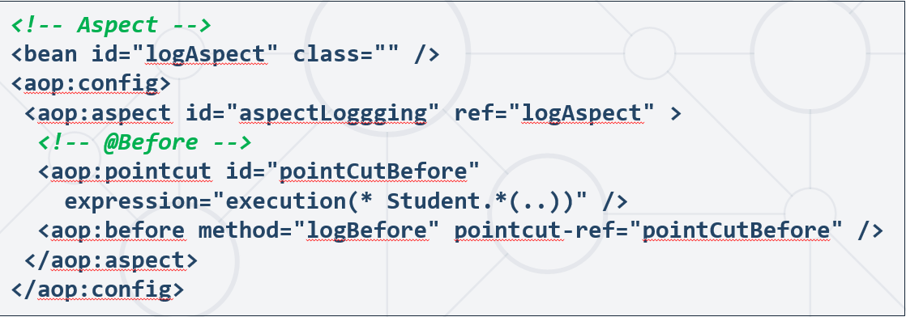
Spring AOP AspectJ (2)
There are two ways to use Spring AOP AspectJ implementation
By annotation
By XML Configuration

Slide 19
AspectJ Annotations in Spring (1)
@Aspect
Declares the class as aspect
@Pointcut
Declares the pointcut expression
@Before
Declares the before advice
Applied before calling the actual method

Slide 20
AspectJ Annotations in Spring (2)
@After
Declares the after advice
Applied after calling the actual method and before returning result
@AfterReturning
Declares the after returning advice
Applied after calling the actual method and before returning result, can get the result value in the advice

Slide 21
AspectJ Annotations in Spring (3)
@Around
Declares the around advice
Applied before and after calling the actual method
@AfterThrowing
Declares the throws advice
Applied if actual method throws exception

Slide 22
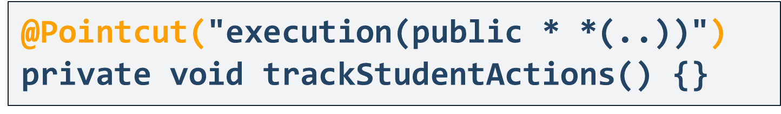
Pointcut
Pointcut is an expression language of Spring AOP
@Pointcut annotation is used to define the pointcut
We can also refer the pointcut expression by name

Slide 23
Pointcut Expressions
Applied on all the public methods
Applied on all methods of Student class
Applied on all setter methods of Student class
Applied on all methods of class that returns an int value
@Pointcut("execution(public * *(..))")
@Pointcut("execution(* Student.*(..))")
@Pointcut("execution(* Student.set*(..))")
@Pointcut("execution(int Student. *(..))")

Slide 24
Examples
Live Demonstration

Slide 25
Prepare for AOP Examples
You remember from previous slides our Student class
public class Student {
public void actionOne(){...};
public void actionTwo(){...};
public void actionThree(){...};
public void actionFour(){...};
public void actionFive(){...};
}

Slide 26
Create Aspect Class
We need to create a class with @Aspect, that contains all advices
@Aspect
@Configuration
public class TrackStudent{
@Pointcut("execution(* Student.*(..))")
public track(){}
//Can have more than one pointcuts
//Here place all advices
}

Slide 27
@Before Example
Add before advice to our TrackStudent class
@Aspect
@Configuration
public class TrackStudent {
@Pointcut("execution(* Student.*(..))")
public track(){}
@Before("track()") // Execute before track pointcut
public void beforeAdvice(JoinPoint joinPoint){
System.out.println("Before advice executed");
}}

Slide 28
@After Example
Add after advice to our TrackStudent class
@Aspect
@Configuration
public class TrackStudent {
@Pointcut("execution(* Student.*(..))")
public track(){}
@After("track()") // Execute after track pointcut
public void afterAdvice(JoinPoint joinPoint){
System.out.println("After advice executed");
} }

Slide 29
@AfterReturning Example
Add after returning advice to our TrackStudent class
...
@AfterReturning
(pointcut="execution(* Student.action())",returning="result")
public void afterReturning(JoinPoint joinPoint, Object result){
System.out.println("AfterReturning advice executed");
//In AfterReturning we can get the result of pointcut
}
...

Slide 30
@Around Example
Add around advice to our TrackStudent class
@Around("track()")
public Object aroundAdvices(ProceedingJoinPoint pjp) throws Throwable {
System.out.println("Before calling");
Object obj = pjp.proceed(); //We need to pass the pjp references in the advice method, so that we can proceed the request by calling the proceed method
System.out.println("After calling");
}
...

Slide 31
@AfterThrowing Example
Add after throwing advice to our TrackStudent class
...
@AfterThrowing
(pointcut="execution(* Student.action())",throwing="error")
Public void afterReturning(JoinPoint joinPoint, Throwable error){
System.out.println("AfterReturning advice executed");
System.out.println("Exception is: " + error);
//In AfterThrowing we can get the exception
}
...

Slide 32
Specifying Aspects Ordering
There are two ways:
By annotation
By implementing interface
@Aspect
@Order(0)
public class TrackStudent{//...}
@Aspect
public class TrackStudent implements Ordered {
//Override this method
public int getOrder(){ return 0; }
}

Slide 33

Summary
…
…
…
AOP – Aspect Oriented Programming
Breaks the program logic into distinct parts (called concerns)
Maintenance is easy in AOP
Spring AOP AspectJ Annotation
The widely used approach is Spring AspectJ Annotation Style

Slide 34
Questions?
Notes:
34

Slide 35














SoftUni Diamond Partners

Slide 36

Educational Partners

Slide 37
Trainings @ Software University (SoftUni)
Software University – High-Quality Education, Profession and Job for Software Developers
softuni.bg, about.softuni.bg
Software University Foundation
softuni.foundation
Software University @ Facebook
facebook.com/SoftwareUniversity
Software University Forums
forum.softuni.bg
Notes:
37

Slide 38

License
This course (slides, examples, demos, exercises, homework, documents, videos and other assets) is copyrighted content
Unauthorized copy, reproduction or use is illegal
© SoftUni – https://about.softuni.bg/
© Software University – https://softuni.bg
Notes:
38

